Slide 1
Microsoft -Classifying Cybersecurity Incidents
Domain: Cybersecurity and Machine Learning
Vijay Moses

Slide 2
Problem Statement
As a data scientist at Microsoft, I was tasked with enhancing the efficiency of Security Operation Centers (SOCs) by developing a machine learning model that can accurately predict the triage grade of cybersecurity incidents. Utilizing the comprehensive GUIDE dataset, your goal is to create a classification model that categorizes incidents as true positive (TP), benign positive (BP), or false positive (FP) based on historical evidence and customer responses.
TP - A legitimate threat that is detected, BP - A legitimate activity or process that is sometimes mistaken for a malicious threat and FP - An alert that suggests a potential threat but is actually harmless
The model should be robust enough to support guided response systems in providing SOC analysts with precise, context-rich recommendations, ultimately improving the overall security posture of enterprise environments.

Slide 3
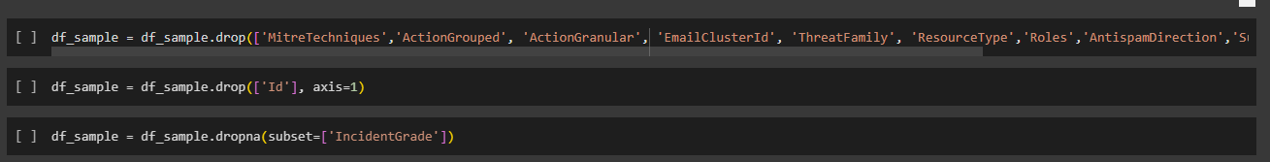
Data Cleaning & preprocessing
Handling Missing Data: Deleting null values in IncidentGrade(Target Column) and droping 10 Columns('MitreTechniques','ActionGrouped', 'ActionGranular', 'EmailClusterId', 'ThreatFamily', 'ResourceType','Roles','AntispamDirection','SuspicionLevel','LastVerdict') with more than 60% null values.

Slide 4
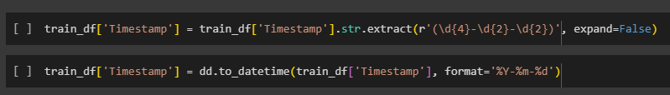
Feature Engineering: created a new feature ‘Day of week’ from the column ‘TimeStamp’.

Slide 5
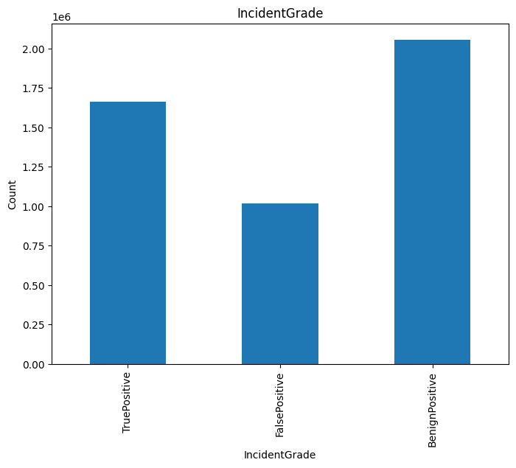
EDA
1. Imbalances in the Classes

Slide 6
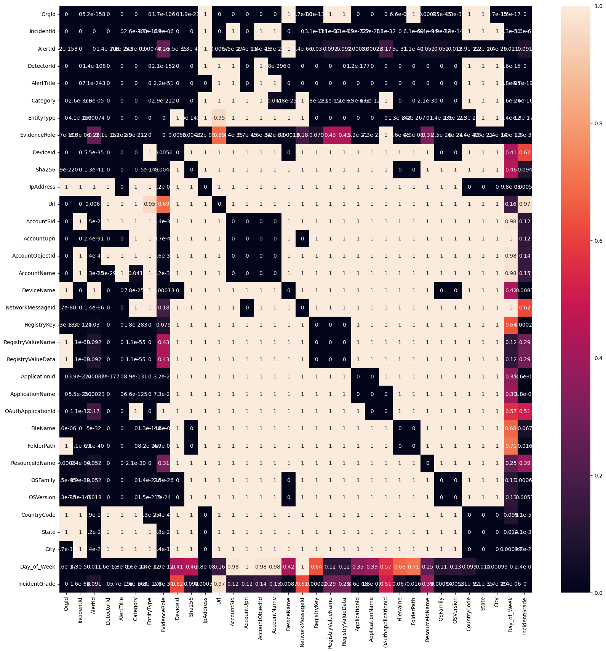
Correlation: chi-squared test

Slide 7
Removing features that are not significantly correlated. ('AlertId','DeviceId', 'Url','AccountSid', 'AccountUpn', 'AccountObjectId','AccountName','NetworkMessageId', 'RegistryValueName','RegistryValueData','OAuthApplicationId', 'ResourceIdName‘).

Slide 8
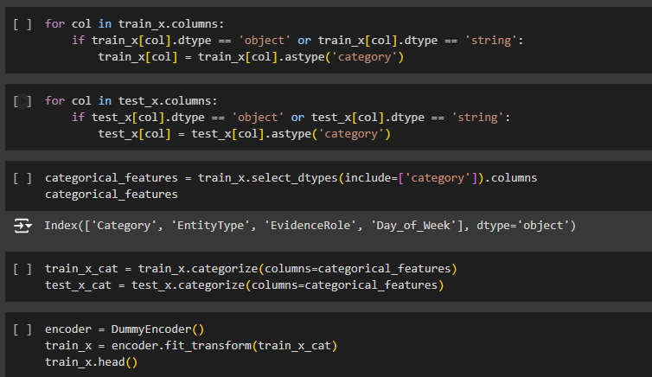
OneHotEncoding: Categorical to numerical column.

Slide 9
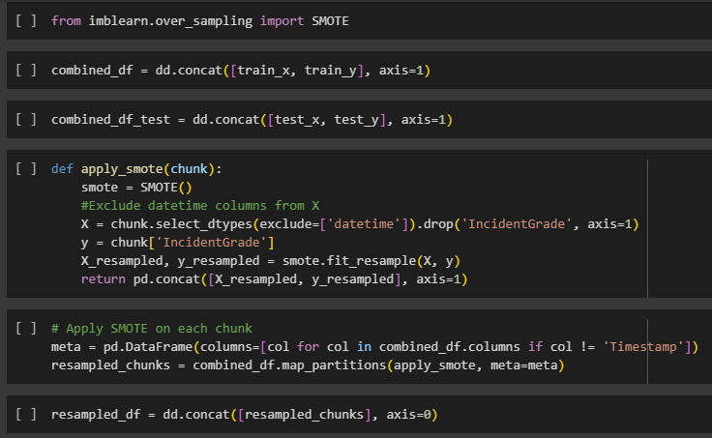
SMOTE

Slide 10
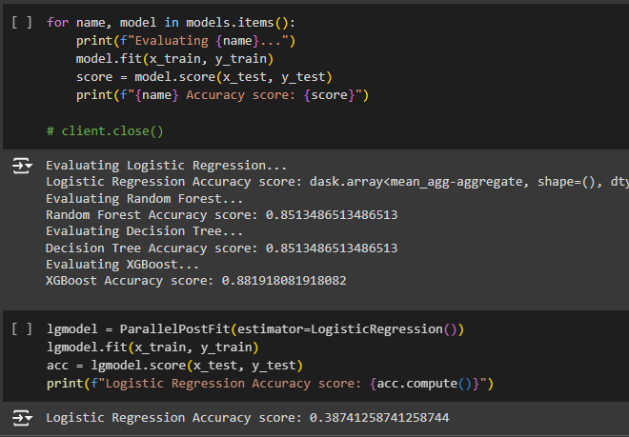
Model Evaluation

Slide 11
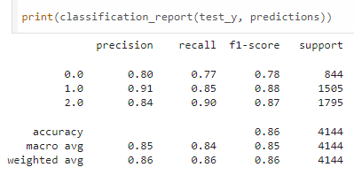
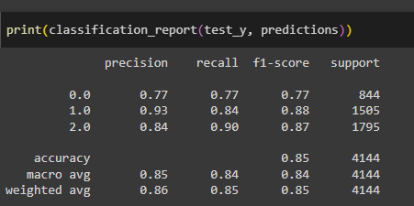
Final model report
Report_1
Report_2

